Slide 1

SURROGATE PARENTING.

Slide 2
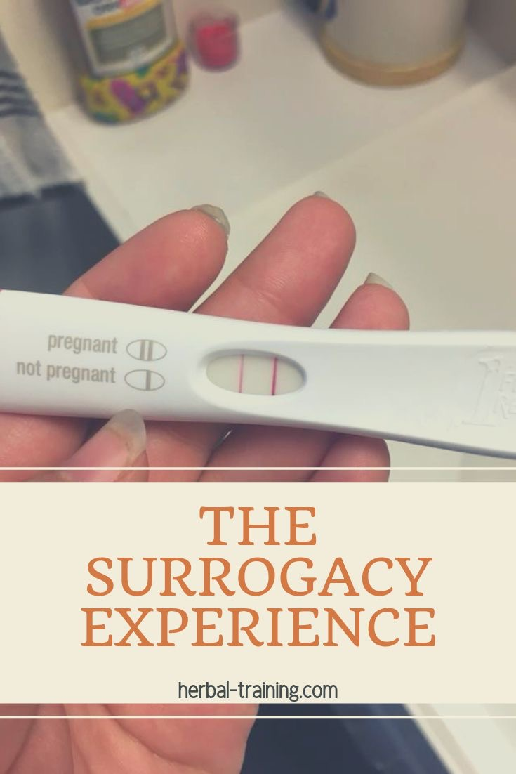
Major arguments of the proponents and opponents of surrogate parenting.
Definition; surrogate parenting is an alternative method of reproduction in couples whereby a surrogate mother is artificially inseminated or surgically implanted of a fertilized eggs for the purposes of carrying the fetus.
Proponents arguments.
It allows genetic connections.
Completes families for couples that struggle with medical conditions and LGBT couples.
Surrogacy is legal thus everyone's expectations are negotiated prior to embryo transfer.
Intended rearing parents are typically more affluent than most of the surrogates they hire.
Intended rearing parents and surrogates have and maintain good relationship with each other thus no harm befalls the child in question.
Opponents arguments.
Exploitation of poor, young, single or ethnic/minority women desperate for money as baby machines.
Surrogacy arrangements risk commoditization of babies as goods or products.
Its complicated in the sense of medical procedures and surrogacy laws involved.
It is expensive due to number of people and services required for its success thus it is for the wealthy only.

Slide 3

Ethical principles validated or violated by surrogate parenting.
Validated.
Allows intended parents to have a child of their own regardless of any medical or other factors that would prevent them from being able to do so.
Surrogate mothers are satisfied and conscious of their choice in taking the responsibility of carrying someone’s child, an indication of positive experience.
Violated.
Attachment with the gestation mother in the sense that she needs to physically and emotionally detach herself from the child once it’s born.
Identity of the child brought to mind in terms of informing the child of his/her surrogate mother by the intended parents.
Human dignity of the surrogate mother since surrogacy is viewed as luxury only available to the wealthy and also the thought of pregnancy for hire.
Status of the child is relegated to that of a commodity.

Slide 4

Code provisions or interpretative statements either validated or violated by surrogate parenting.
The prime ethical concerns raised in the whole system of surrogate parenting is regarding the concern about the exploitation, commodification and coercion when women are paid to be pregnant and deliver babies especially in cases where there are large wealth and power differences between intended parents and surrogates.
However, the counter to it is a woman’s right to enter into a contract and to make decision regarding her own body. The commodification arrangement raises the argument whether women are being given control over their body or being exploited for their individual body parts.

Slide 5

Potential outcomes of surrogate parenting for patients, health care system, the costs of health care and health providers.
Most surrogacy arrangements are successfully implemented.
Surrogacy mothers are well motivated thus have little difficulty separating from the children born as a result of the arrangement.
No serious psychopathology among the surrogate mothers and their motives are mostly altruistic but financial reasons.
The perinatal outcome of the children is comparable to standard IVF and oocyte donation and there is no evidence of harm to the children born as a result of surrogacy.

Slide 6
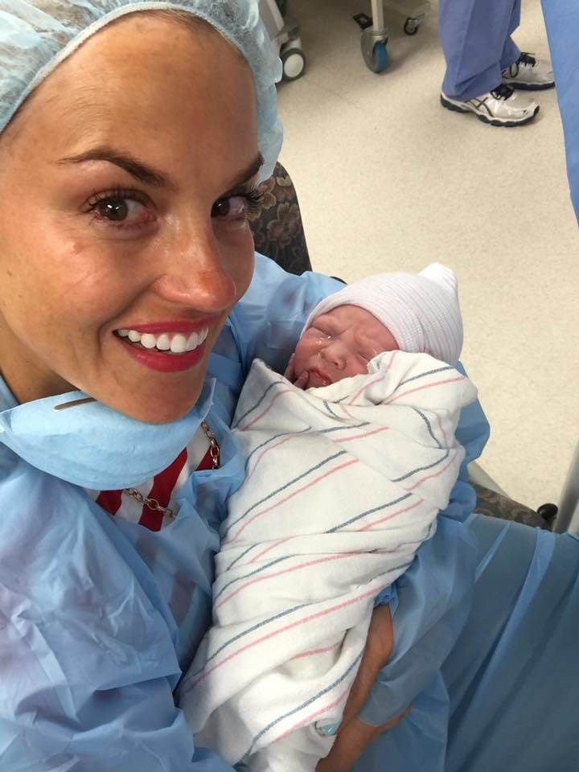
Impact of surrogate parenting on nursing practice by 2025 if allowed to succeed
Surrogacy programs if fully accepted they promote advances in medical technology thus aiding protecting the health and well-being of an even larger portion of the society.
Creation of a strong workforce for necessary medical staff including the nurses since surrogacy touches far more than just lives of the intended parents.
Creation of legislation creating standards to ensure voluntary, informed consent to establish paternity and maternity and to require medical screening of donors and surrogates.

Slide 7

Ethical challenges to be faced by nurses in regards to surrogate parenting.
Informed consent: concerns by the nurses that the patient and their families have not been informed of the surrogacy medical procedures and the risks involved in surrogate parenting.
Patient privacy: nurses have access to patient’s records and thus cannot ethically or legally release that information to anyone besides the patient. This becomes a challenge where the intended parents want to access medical information in regards to the surrogate.
Surrogate decision making: a challenge arises in cases where the nurses are torn between whose decision to follow in regards to the child in question between the intended parent or the surrogate mother.

Slide 8
REFERENCES.
American College of Obstetricians and Gynecologists. “Ethical issues in surrogate motherhood.” (ACOG Committee Opinion 88). Washington DC; ACOG, 1990.
Blythe, Eric and Ruth Landau. Third Party Assisted Conception across Cultures: Social, Legal and Ethical Perspectives (London: Jessica Kinsley Publishers, 2004)

